Slide 1
Northwind Data Analysis Project
Comprehensive Business Insights
Project by:
Anfal Mahmoud
Esraa Ebrahim
Mohamed Alqmash

Slide 2
Agenda Slide:
We'll cover the following topics:
Introduction to the Project
Overview of the Data and Relationships
Key Analysis and Findings By SQL
Preprocessing through Power Query
Visualizations through Power BI
Recommendations for Improvement
Next Steps for Implementation
Conclusion
Q&A

Slide 3
1. Introduction to the Project:
Objective: The purpose of this analysis is to extract valuable business insights from the Northwind dataset, a classic example of sales, product, customer, and employee data. Our goal is to analyze sales performance, customer trends, shipping efficiency, and employee productivity to provide actionable insights for decision-making.
Throughout this presentation, I will showcase how we used SQL for querying the data, Power Query for Pre-processing Data, and Power BI for visualizing the results.

Slide 4
2. Data Overview Slide:
Let's start by looking at the data we have. The Northwind dataset consists of several tables representing different aspects of the business:
Orders: This contains detailed information about the sales transactions.
Customers: This table lists all the customers who have made purchases.
Products: Includes information about the products that were sold.
Employees: Data about the employees who handled the orders.
Shippers: Information about the companies responsible for shipping the orders.

Slide 5
Schema and Relationships:
The dataset is well-structured with clear relationships between tables. For example:
Each order is linked to a customer and an employee.
Products are linked to orders and categorized by product type.
Shippers handle the delivery of each order.
These relationships help us extract insights from multiple angles.

Slide 6
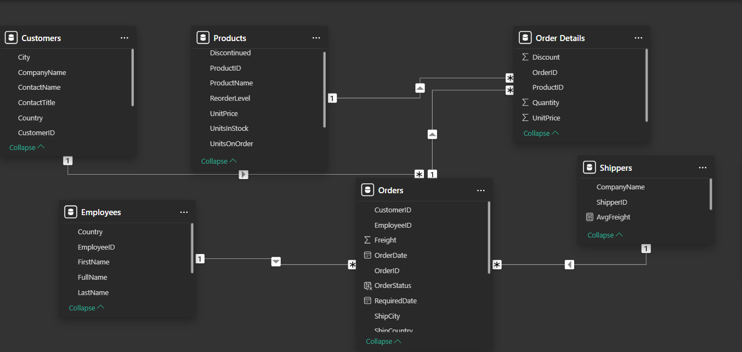
Model View:

Slide 7

3. Key Analyses and Findings Slides:

Slide 8
3.1. Product Revenue Analysis:
This query calculates the total revenue generated by each product by multiplying the quantity sold by the unit price. It ranks products based on their total revenue. This analysis provides key insights such as:
Top Revenue-Generating Products: Identifying which products contribute the most to the company's revenue helps prioritize marketing and sales efforts.
Sales Trends: Understanding which products drive the most revenue over time can guide product development and promotions.
Inventory Optimization: By focusing on high-revenue products, the business can manage stock levels more effectively, ensuring availability of the best-selling items.

Slide 9
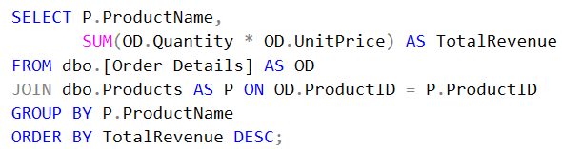
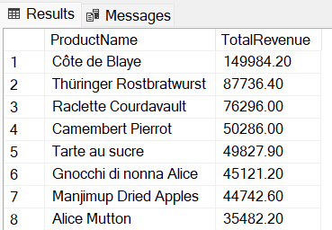
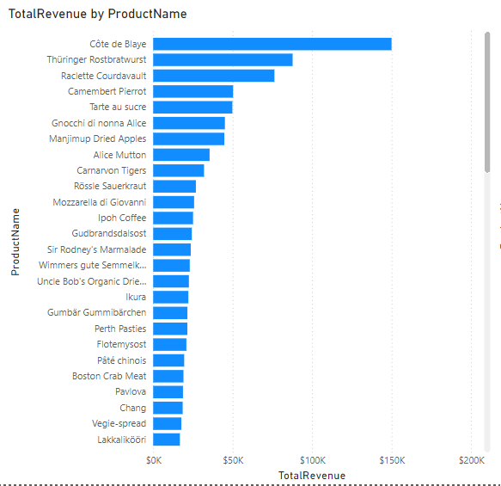
Here’s a Queries and chart showing Product Revenue Analysis:

Slide 10
3.2. Customer Spending Analysis:
This query calculates the total amount spent by each customer by summing the quantity and unit price for all their orders. The customers are ranked in descending order based on their total spend. This analysis provides the following key insights:
Identify High-Value Customers: Recognizing which customers contribute the most to sales allows the business to focus on maintaining and nurturing relationships with them.
Targeted Marketing: The company can design personalized marketing campaigns and loyalty programs for top spenders to improve retention.
Revenue Growth: By understanding which customers generate the most revenue, the company can allocate resources effectively to maximize future sales.

Slide 11
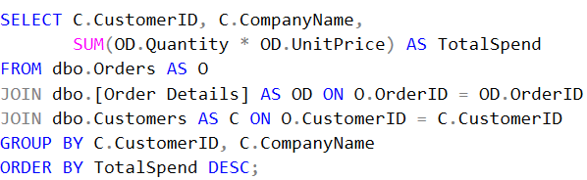
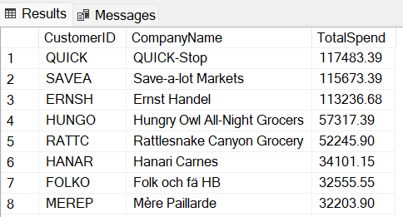
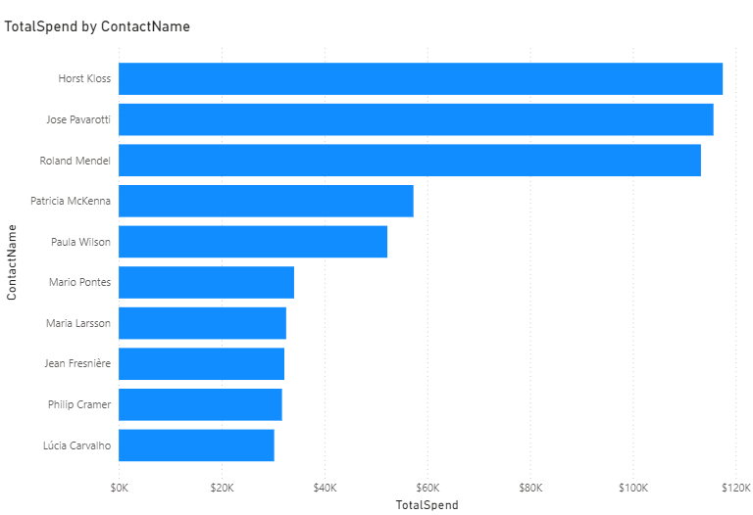
Here’s a Queries and chart showing Customer Spending Analysis:

Slide 12
3.2.1. Top Products Purchased by Each Customer:
In this query, we identified the most purchased product by each customer, calculating both the total amount spent and the total quantity of that product. This helps in understanding customer preferences and spending patterns, allowing us to:
Enhance Product Recommendations: Knowing which product a customer buys the most can help personalize future offers.
Optimize Inventory: Focus on stocking high-demand products for specific customers to meet their needs better.
Target High-Value Customers: Customers spending the most on particular products can be targeted for loyalty programs or special discounts.

Slide 13
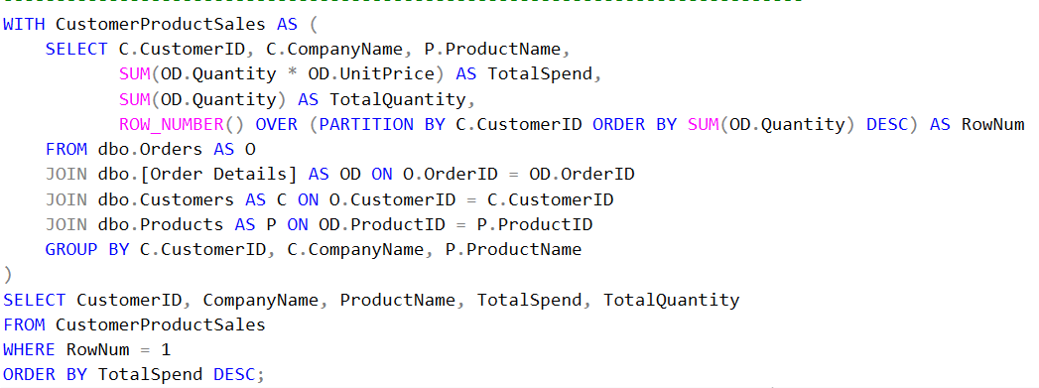
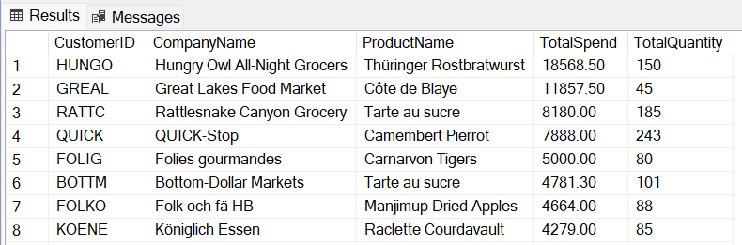

Slide 14
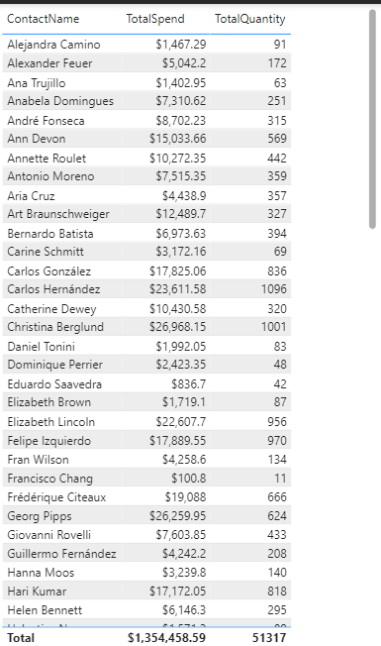

Slide 15
3.3. Employee Order Management Analysis:
This query counts the total number of orders managed by each employee, displaying the employee's full name and the number of orders they handled. The employees are ranked in descending order based on the total number of orders. This analysis provides:
Identify High-Performing Employees: Recognizing which employees handle the most orders allows the company to assess workload and efficiency.
Resource Allocation: Insights from this query help in distributing tasks more evenly among employees or identifying areas where additional support may be needed.
Employee Performance Review: Understanding order management on an employee basis can be used for performance appraisals and to design incentives for top performers.

Slide 16
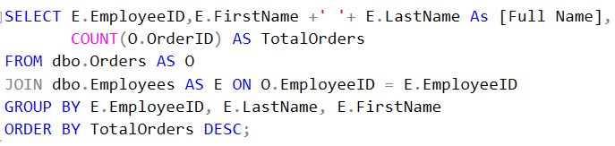
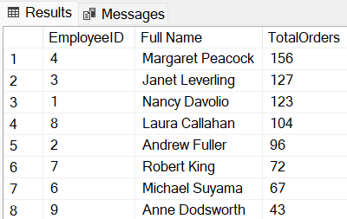
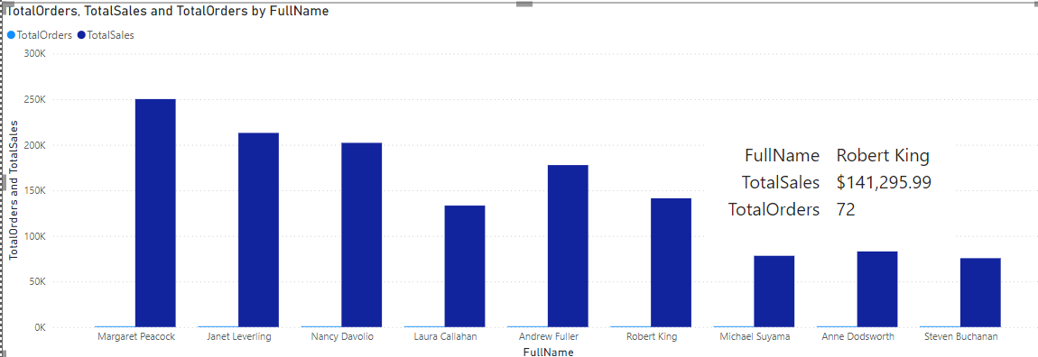
Here’s a Queries and chart ranking employees based on their sales performance:

Slide 17
3.3.1.Top and Total sales value per employee :
This query calculates the total sales made by each employee, showing the Employee ID, Last Name, and First Name, and sorting them by their total sales in descending order. This analysis provides several key insights:
Identify Top Performers: Highlighting which employees are generating the highest sales helps in recognizing top-performing staff.
Targeted Training: It allows for focused training programs to improve the performance of employees with lower sales figures.
Sales Incentives: Insights from this query can be used to establish incentive plans for high-performing employees to boost overall company performance.

Slide 18
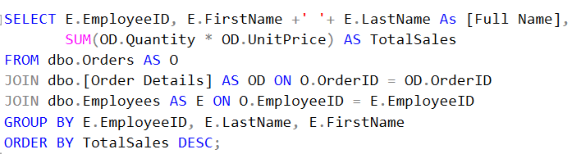
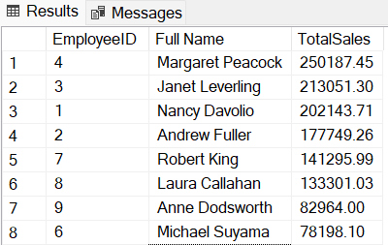
Here’s a Queries and chart showing Employee Order Management Analysis:

Slide 19
3.4. Sales Trends Over Time:
This query calculates monthly sales totals by aggregating the quantity and unit price of orders for each year and month. The output is ordered chronologically, providing insights into sales trends over time. Key benefits include:
Seasonality Insights: Identifying months or periods where sales peak or decline helps businesses adjust marketing and inventory strategies.
Performance Monitoring: Comparing sales performance across different months and years provides a clear picture of growth and any market fluctuations.
Forecasting: Recognizing historical trends enables more accurate sales forecasting, helping in better planning and decision-making.

Slide 20
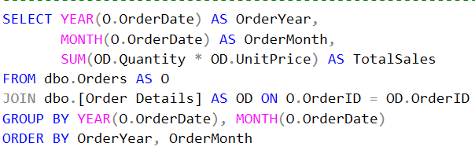
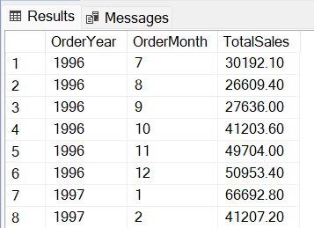
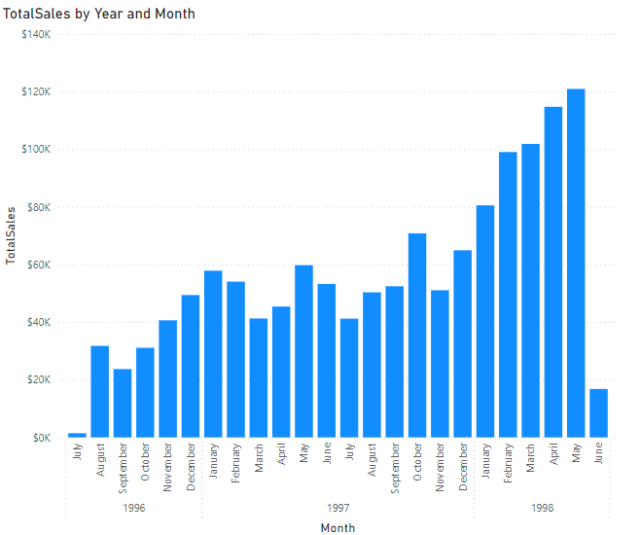
Here’s a Queries and chart showing Sales Trends Over Time :

Slide 21
3.5. Shipping Performance by Shipper and Country:
This query calculates the average shipping time and the average freight cost for each shipper, broken down by the destination country. It excludes orders that have not been shipped. The insights gained include:
Evaluate Shipper Efficiency: By measuring the average shipping time for each shipper and country, businesses can assess which shippers are the most efficient.
Cost Management: The average freight cost helps in determining the shipping costs and optimizing logistics expenses.
Improve Customer Satisfaction: Understanding the shipping performance allows the company to make informed decisions on which shippers to prioritize for specific regions, potentially improving customer experience through faster delivery times.

Slide 22
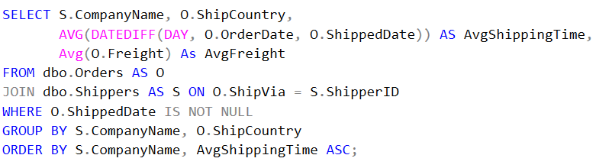
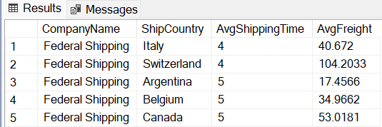
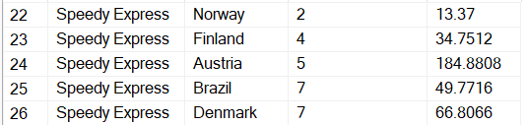
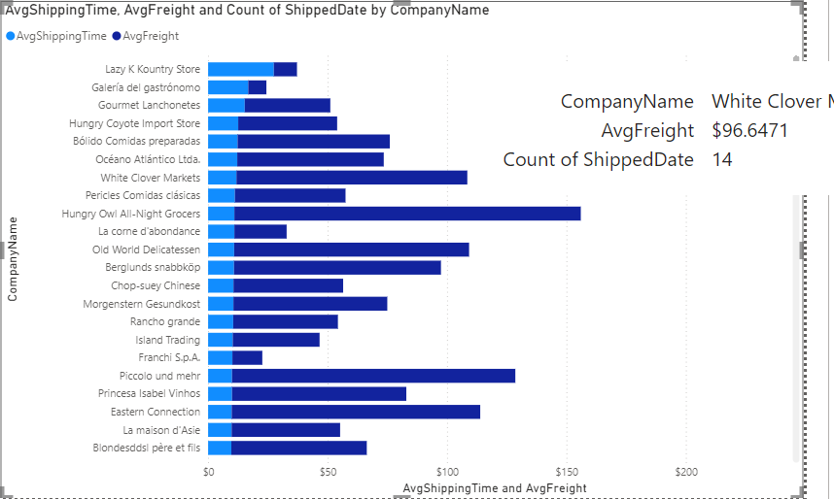
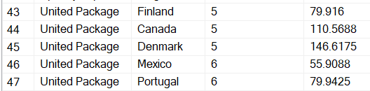
Here’s a Queries and chart showing Shipping Performance by Shipper and Country:

Slide 23
3.6. Product Profitability Analysis:
This query calculates the total profit generated by each product by subtracting the product cost (P.UnitPrice) from the sales price (OD.UnitPrice), then multiplying it by the quantity sold. It helps rank the products based on profitability. Key benefits include:
Identify High-Profit Products: Pinpointing the most profitable products allows the company to focus on promoting and selling those items.
Optimize Pricing: Insights from product profitability can help fine-tune pricing strategies, ensuring that the business maximizes profit margins.
Inventory Decisions: Understanding which products yield the highest profits can guide stocking and inventory decisions, helping ensure the most profitable items are always available.

Slide 24
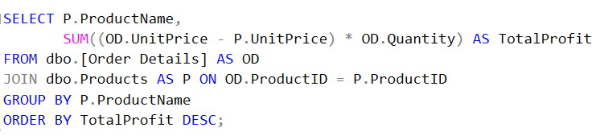
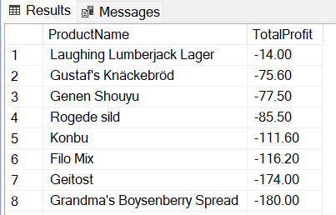
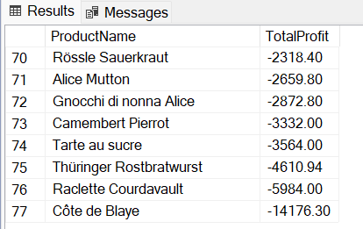
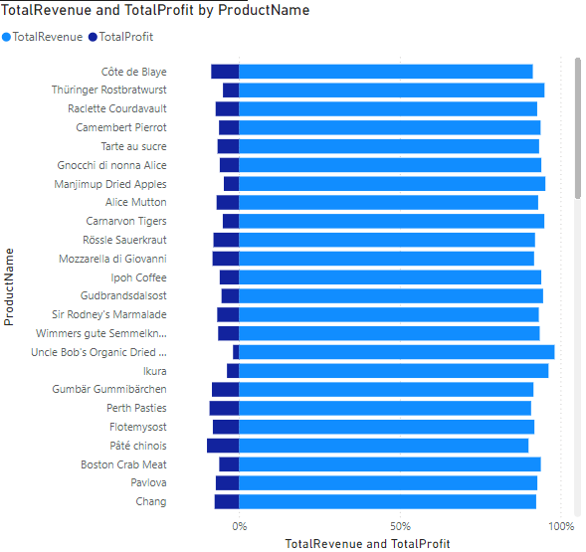


Here’s a Queries and chart showing Product Profitability Analysis:

Slide 25
3.7.Order Delivery Status Analysis:
This query determines the status of each order based on its shipping date and required date. It classifies orders into three categories:
Late: Orders shipped after the required date.
Cancelled: Orders that were never shipped (ShippedDate is NULL).
On Time: Orders shipped on or before the required date.
This analysis helps in:
Assessing Delivery Performance: By identifying late or cancelled orders, the company can evaluate its ability to meet customer expectations.
Improving Logistics: Insights into delivery delays enable the company to optimize supply chain and shipping processes.
Customer Satisfaction: Understanding delivery performance can help address service issues, improving overall customer experience.

Slide 26
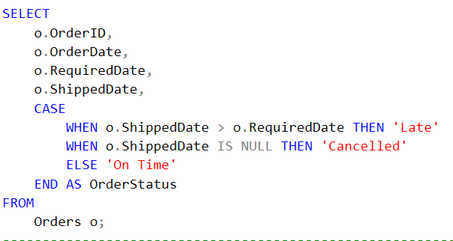
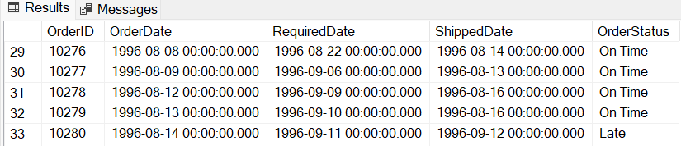

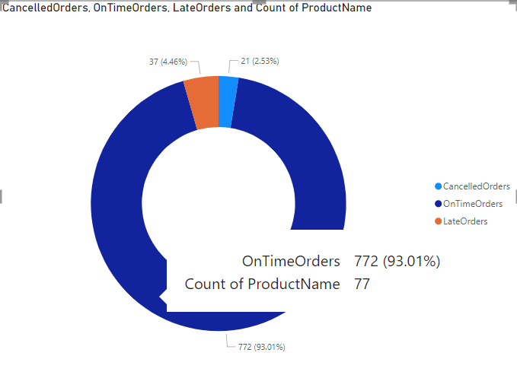
Here’s a Queries and chart showing Order Delivery Status Analysis:

Slide 27
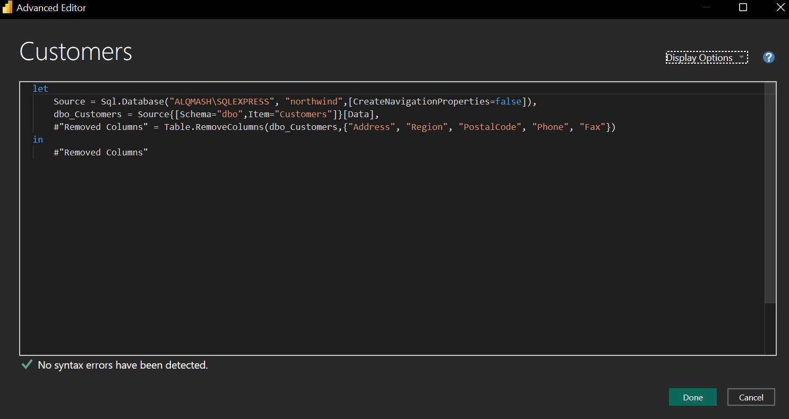
4.1. Preprocessing through Power Query:

Slide 28
For the Customers table, here's what you did in Power Query:
1.Disabled Navigation Properties: You added [CreateNavigationProperties=false] to the Sql.Database function, which prevents Power Query from automatically creating relationships between the Customers table and other related tables. This gives you more control over managing these relationships manually.
2.Loaded the Customers Table: You accessed the Customers table from the dbo schema using:
dbo_Customers = Source{[Schema="dbo", Item="Customers"]}[Data],

Slide 29
3. Removed Unnecessary Columns: You removed columns that are not essential for your analysis. Specifically, you removed: "Address": Customer's street address, which may not be needed in your visualizations. "Region": The region column, possibly not useful for the scope of your analysis. "postal Code": The postal code, which might not contribute directly to your insights. "Phone": Customer phone numbers, which might not be critical for your dashboard. "Fax": Fax numbers, likely outdated or irrelevant.
Summary of Transformations: The goal of these changes is to clean up the Customers table by focusing only on key columns like CustomerID, Company Name, Contact Name, and other critical information. This makes the data more streamlined for your visualizations in Power BI, improving performance and clarity.

Slide 30
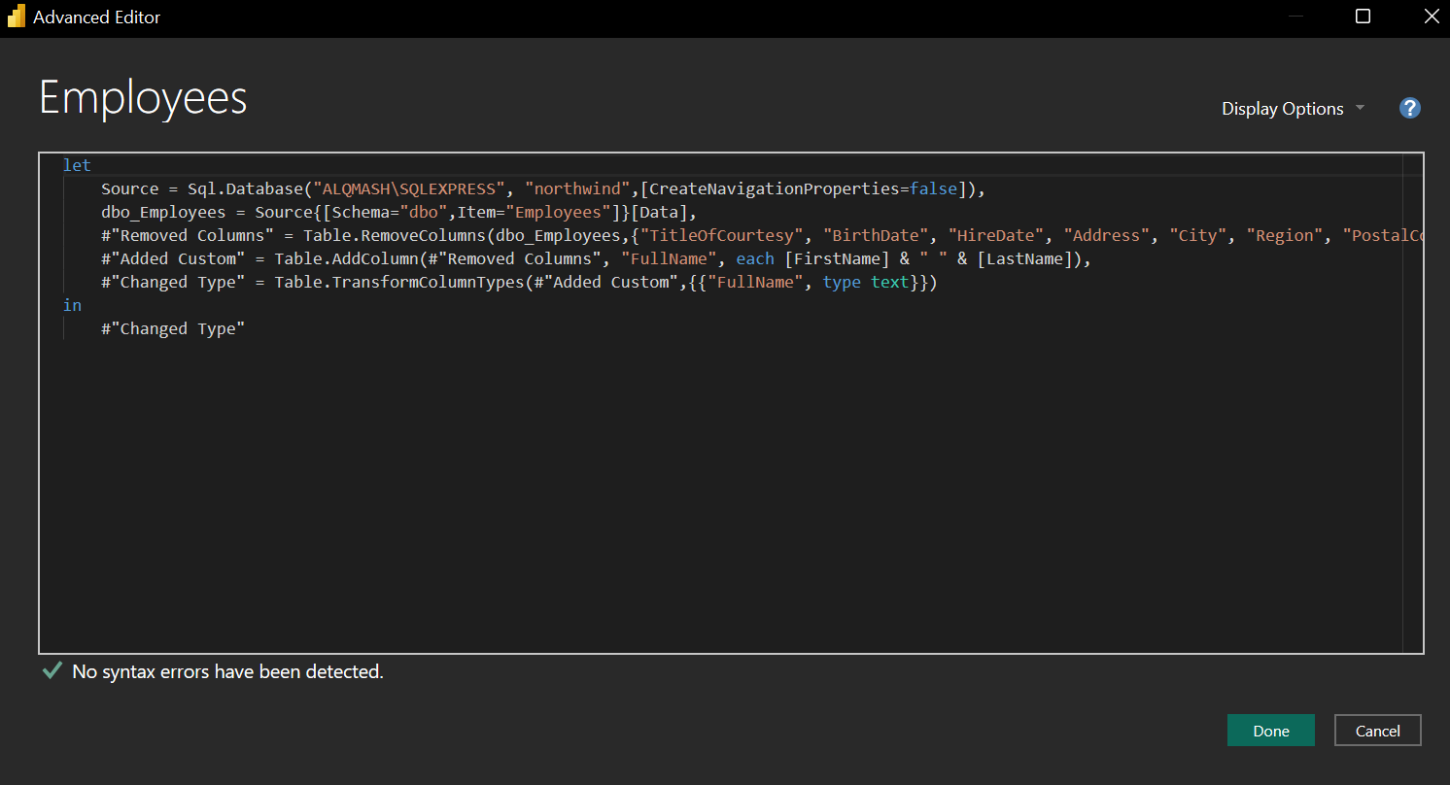
4.2. Preprocessing through Power Query:

Slide 31
4.2. Preprocessing through Power Query:
For the Employees table, here's what you've done in Power Query:
1.Disabled Navigation Properties: Similar to the Customers table, you added [CreateNavigationProperties=false] to the Sql.Database function. This disables automatic relationship creation between the Employees table and other tables.
2.Loaded the Employees Table: You accessed the Employees table from the dbo schema using:
dbo_Employees = Source{[Schema="dbo", Item="Employees"]}[Data],

Slide 32
3.Removed Unnecessary Columns: You removed some columns that aren't essential for your dashboard, including:"TitleOfCourtesy": Titles like Mr., Ms., etc., which may not be necessary for the analysis."BirthDate", "HireDate": These date fields might not be needed for the current visualization goals."Address", "City", "Region", "PostalCode": Geographical and postal details, which might not add value in this context.
4.Added a Custom Column (Full Name):You created a new column "FullName" by concatenating the FirstName and LastName columns:
#"Added Custom" = Table.AddColumn(#"Removed Columns", "FullName", each [FirstName] & " " & [LastName]),

Slide 33
5. Changed Data Type: You ensured that the new "FullName" column has the correct data type, which is text:
#"Changed Type" = Table.TransformColumnTypes(#"Added Custom",{{"FullName", type text}})
Summary of Transformations: In the Employees table, you streamlined the data by removing unnecessary columns, created a new column for the employee's full name to simplify visualizations, and ensured the correct data type for the new column. This will make it easier to work with employee-related data in your Power BI dashboard, especially when displaying employee names in charts or tables.

Slide 34
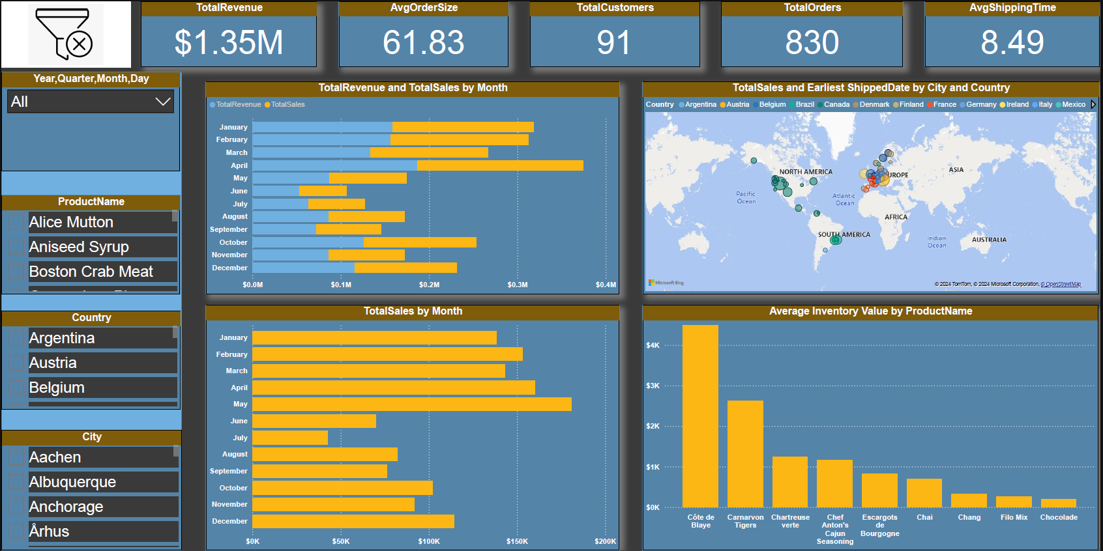
5. Visualizations through Power BI:

Slide 35
1. Key Metrics Cards:
Total Revenue: Displays the overall sales revenue ($1.35M).
Avg Order Size: Shows the average size of orders placed (61.83).
Total Customers: The total number of customers (91).
Total Orders: The total count of orders made (830).
Avg Shipping Time: The average time it takes for an order to be shipped (8.49 days).

Slide 36
2. Filters:
Year/Quarter/Day Filter: Enables filtering the data based on time periods.
Product Name Filter: Allows filtering the data by specific products (e.g., Alice Mutton, Aniseed Syrup).
Country and City Filters: Enables data exploration by geographical location.

Slide 37
3. Charts & Visuals:
Total Revenue and Total Sales by Month: A bar chart comparing revenue and sales across each month of the year.
Total Sales by Month: Another chart focused purely on sales figures over the months.
Map Visual: Depicts the total sales and the earliest shipping dates by city and country, showing global distribution of orders.
Average Inventory Value by Product Name: A bar chart comparing the average inventory value for different products.

Slide 38
4. Insights Provided:
The dashboard allows quick analysis of sales performance by month, product, and location.
Key metrics such as revenue, orders, and shipping time are clearly highlighted for decision-making.
Filters provide flexibility in analyzing different dimensions like time, product, country, and city.

Slide 39
6. Recommendations for Improvement:
This section focuses on recommendations aimed at improving business performance based on the analysis conducted. Here are potential areas for improvement:
Inventory Management Optimization: Based on the analysis of high-performing and low-performing products, the company can improve inventory management by focusing on stocking high-demand products and better managing low-performing items. This can reduce stockouts and excess inventory.
Enhancing Customer Experience: By identifying top-spending customers, the company can develop targeted marketing campaigns and special offers for these high-value customers. This will help increase customer loyalty and drive repeat business.
Improving Shipping Efficiency: Through the analysis of shipping performance by shipper and country, the company can enhance logistical efficiency by selecting the most reliable and fastest shippers based on the destination. This can reduce shipping times and potentially lower shipping costs.
Boosting Employee Performance: Based on the employee performance analysis, the company can create focused training programs for underperforming employees and introduce incentive programs for top-performing staff to motivate and improve overall productivity.

Slide 40
7. Next Steps for Implementation:
This section outlines the actionable steps for implementing the recommended improvements based on the analysis. The next steps typically include:
Implementing Optimized Inventory Management: Using insights from the sales and product performance analysis, the company can implement automated inventory reorder systems for high-demand products to ensure they are always available.
Enhancing Marketing Strategies: By leveraging the customer and sales analysis, the company can develop more targeted marketing strategies to increase sales and customer retention, particularly focusing on high-spending customers.
Streamlining Shipping Processes: After evaluating the shipping performance, the company can renegotiate contracts with shipping providers to ensure faster and more cost-effective deliveries. Additionally, specific shippers can be prioritized for certain regions based on their efficiency.
Launching Employee Incentive Programs: Using the employee performance analysis, the company can introduce reward programs for high-performing employees to motivate them further. Training programs should also be implemented to support employees who need improvement.

Slide 41
8. Conclusion:
In conclusion, our analysis has provided clear insights into the company's sales performance, customer behavior, and operational efficiency. By implementing the recommended changes, we can drive better business outcomes and improve overall profitability.

Slide 42

9. Q&A:
I now welcome any questions you may have about the analysis or findings.

Slide 43

Thanks

